Slide 1
Geometric criteria of hydrogen bonds in proteins and identification of `bifurcated' hydrogen bonds
Ivan Y. Torshin, Irene T. Weber and Robert W. Harrison
Protein Engineering, Vol. 15, No. 5, 359-363, May 2002
Presenter: Tsung-Jung Tsai (蔡宗容)
Date: Sept. 26, 2007

Slide 2
Abstract (1/2)
Empirical criteria for identification of hydrogen bonds were analyzed to produce a set of geometrically consistent criteria(一貫的標準). For a data set of 30 structures, application of a set of purely geometrical criteria, along with exclusion of abnormal backbone conformations, also excluded a common interaction of Ser/Thr side chains with Asp/Glu side chains ([ST]/[DE] pairs).

Slide 3
Abstract (2/2)
These interactions were termed `bifurcated hydrogen bonds(分叉型氫鍵)‘, which implies delocalization(非區域化) of a positively charged hydrogen of hydroxyl between the two acceptor atoms of the carboxylic group. These `bifurcated' interactions are among the most common packing patterns for [ST]/[DE] pairs of side chains. Therefore, the identification of hydrogen bonds cannot be based on geometrical criteria only and requires introduction of some physic-chemical criteria.

Slide 4
Hydrogen bond (氫鍵) (1/3)
The hydrogen bond is an interaction between two electronegative atoms (陰電性原子/電負度原子), donor and acceptor(施體與受體), through an intermediate atom of hydrogen that is covalently connected with the donor.
donor
acceptor
Notes:
分子間作用力的敘述：
氫鍵是一種相當強的分子間偶極-偶極作用力， 由兩個陰電性大的原子與處在其中間作為橋樑的氫原子所組成， 可以寫為 A-H …… B 。 氫原子與其中一個原子 A 形成共價結合， 而以靜電作用力與另一個原子 B 相互作用。 由於 原子 A 的強大陰電性， 使得氫原子的電子雲被吸引過去， 氫原子因而帶相當強的正電， 同時受到另一個分子上的 B原子之負電吸引而形成氫鍵。

Slide 5
Hydrogen bond (氫鍵) (2/3)
The electron density of the bond donor atom-hydrogen is shifted to the donor atom, thus a positive charge is induced(感應出) on the hydrogen.
This partial charge interacts with the electronic cloud(電子雲) of the acceptor atom.
+
donor atom
acceptor atom
Notes:
分子間作用力的敘述：
氫鍵是一種相當強的分子間偶極-偶極作用力， 由兩個陰電性大的原子與處在其中間作為橋樑的氫原子所組成， 可以寫為 A-H …… B 。 氫原子與其中一個原子 A 形成共價結合， 而以靜電作用力與另一個原子 B 相互作用。 由於 原子 A 的強大陰電性， 使得氫原子的電子雲被吸引過去， 氫原子因而帶相當強的正電， 同時受到另一個分子上的 B原子之負電吸引而形成氫鍵。

Slide 6
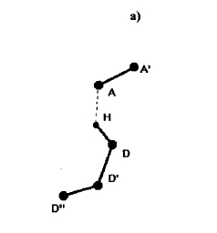
Hydrogen bond (氫鍵) (3/3)
Unlike the covalent bond, the hydrogen bond is a multipole interaction(多極交互作用) involving at least three atoms(D,H and A).
Describe a triangle DHA：
(1) three sides
(2)two sides, a angle
DH, HA, and the angle DHA

Slide 7
Characterize
Unlike a covalent bond, hydrogen bonds are characterized not by specific bond lengths and angles, but by using broader ranges of values(範圍較廣的值).
In order to determine these ranges for proteins, it is necessary to carry out measurements of these parameters in a number of protein structures.

Slide 8
Materials and method
Geometric criteria of hydrogen bond identification
Using statistical analysis for approximately 50 protein structures.
The following empirical rules(經驗法則) of hydrogen bond identification were proposed:
  Rule 1 : D－A < 3.9 Å
  Rule 2 : H－A < 2.5 Å
  Rule 3 : D－H－A > 90.0 °
  Rule 4 : A’ － A－D > 90.0 °
  Rule 5 : A’ － A－H > 90.0 °
Notes:
These rules were analyzed in order to define a minimal geometrically consistent set of the criteria.

Slide 9
Specification
Input
Assuming that D and H coordinates are given
Output
Let us consider a set of all
possible acceptor coordinates
called the ‘A-set’
acceptor atom
donor atom

Slide 10

Rule 1 : D－A < 3.9 Å
A-set
A-set
Sphere D
H
Ｄ
3.9 Å
Ｄ’

Slide 11
Rule 2 : H－A < 2.5 Å
Sphere H
A-set
Sphere D
2.5 Å
H
Ｄ
3.9 Å
Ｄ’
Distance DH is ~1 Å

Slide 12
Rule 3 : D－H－A > 90.0 °
Sphere H
A-set
2.5 Å
H
Ｄ
Ｄ’

Slide 13
Rule 4 : A’ － A－D > 90.0 °
Rule 5 : A’ － A－H > 90.0 °
Sphere H
A’
A
A
A’
H
H
A-set
A-set
Ｄ
Ｄ
Ｄ’
Ｄ’

Slide 14
Calculation of hydrogen atom positions in proteins
In X-ray crystallography, the atomic coordinate are determined by fitting a model to the experimental electron density map.
Resolution: 1.5 ~ 2.5 Å
The positions of the hydrogen atoms cannot be determined.

Slide 15
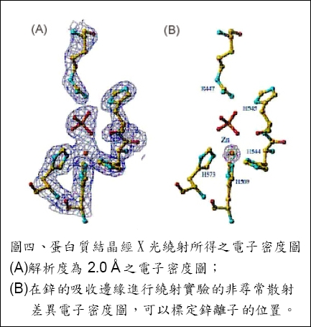

Slide 16
Calculation of hydrogen atom positions in proteins
Thus, position of hydrogen atoms were calculated using coordinates of the donor, angle D’-D-H and distance D-H.
donor atom

Slide 17
Hydrogen donor protein atoms
NH of the main chain,
ARG NE
ASN ND2
HIS NE2
SER OG
TYR OH
ARG NH1
CYS SG
HIS ND1
THR OG1
ARG NH2
GLN NE2
LYS NZ
TRP NE1

Slide 18
Acceptor atoms
Carboxyl oxygen of the main chain
ASN OD1
GLN OE1
MET SD
ASP OD1
GLU OE1
SER OG
ASP OD2
GLU OE2
THR OG1
CYH SG
HIS ND1
TYR OH

Slide 19
